Slide 1
The Nazi Party
Methods of control: The SA
Using Source Material

Slide 2
Lesson Objectives
In this lesson you will develop an understanding of:
How the SA (Brownshirts) were used
Hitler’s views on democracy
You will develop these historical skills
Analysing the use of sources
Inferring things from source material
Structuring of answers to attain high marks.

Slide 3
Purpose of the SA
The SA (Brownshirts) were directed to keep order at party meetings
Later the SA were deployed to break up meetings of other parties
Wore military style uniforms and used force to achieve ‘order’
Intended to provide a strong image

Slide 4
Evidence
Source 1
The trouble had not begun when my storm troopers attacked. Like wolves, they flung themselves in packs of eight or ten upon the enemy. After only five minutes, I hardly saw one of them who was not covered in blood. The hall looked as if a shell had struck it. Many of my supporters were being bandaged, others had to be driven away, but we had remained the masters of the situation.
Adolf Hitler, 1925

Slide 5
Using the evidence
What does this source tell us?
That the Storm Troopers attacked opponents of the Nazi Party
That many of them were injured in the attack
That Hitler was present when this attack happened
That Hitler was most concerned with ensuring that the Nazi Party remained in control
That men were willing to fight for the Nazi Party
That dissent was not permitted

Slide 6
Using the evidence
What are the limitations of this source?
The source isn’t specific to time or place
No mention of who was attacked or why they were attacked
No mention of the numbers of men involved
The source doesn’t mention the organisation of the SA

Slide 7
Is the Source useful to a historian?
It clearly has it’s uses. The extract is from Mein Kampf, so it provides us with Hitler’s own image of his Stormtroopers: which is useful for a historian to know. It also illustrates, briefly, how the SA reacted to dissent at meetings.
The Source is limited in that it doesn’t provide any detail as to who was involved, what they reacted to or whether or not the SA were ordered to attack.
A historian would need much more information about the SA if an objective analysis of the organisation was to be made. No mention is made here of the organisation of the SA, it’s function can only be inferred and the source is undoubtedly heavily bias.

Slide 8
Answering ‘usefulness’ questions
Recommended structure
State the uses of the source in your opening paragraph.
Refer directly to the source here to make your understanding of the content explicit to the examiner. If the source supports a popular interpretation of events it would be wise to make reference to that here as well. (Only do this if you are sure though)
Identify and state the limitations of the source in the second paragraph.
No source tells you everything! What else would a historian need to know? Are there any mistakes in the source, is it bias?
Assess the sources usefulness in your closing paragraph.
Provide an objective overview of how useful the source is.

Slide 9
Now answer the question!
The trouble had not begun when my storm troopers attacked. Like wolves, they flung themselves in packs of eight or ten upon the enemy. After only five minutes, I hardly saw one of them who was not covered in blood. The hall looked as if a shell had struck it. Many of my supporters were being bandaged, others had to be driven away, but we had remained the masters of the situation.
Adolf Hitler, 1925
Explain how useful the above source is to a Historian studying this aspect of Nazi Germany.
Time allowed: 20 minutes

Slide 10
Final check list
Does your answer:
State the uses of the source?
State the limitations of the source?
Make use of your knowledge to place the sources uses in context?
Make sure you haven’t:
Repeated yourself
Made suggestions that aren’t backed up
Made spelling mistakes

Slide 11
How this type of question is marked
0 marks: nothing of relevance
1-2 marks: offers a general statement suggesting that the source may or may not be of use to a historian. The answer might quote from the source to support the claim.
3-4 marks: answer recognises that there are uses and limitations of the source. These will be explained briefly. Student may quote from the source to support answer. This answer lacks detailed substantiation of major points.
5-6 marks: answer clearly recognises that there are several uses of the source and explains these in the context of a study of the period. The student also explains the limitations of the source, making reference to other knowledge they have acquired to illustrate this clearly. The answer is objective in approach and does not jump to conclusions

Slide 12
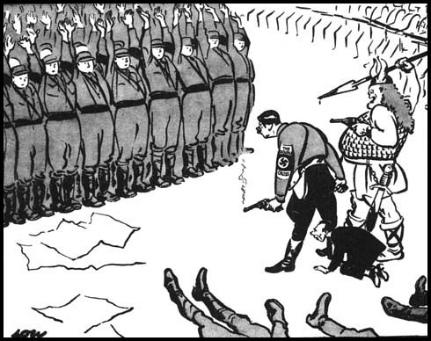
Checking your understanding
Cartoon by David Lowe, British cartoonist. 1934
How useful is this source to a Historian studying the nazi parties methods of control?
Time allowed: 20 minutes (including planning time)

